Slide 1


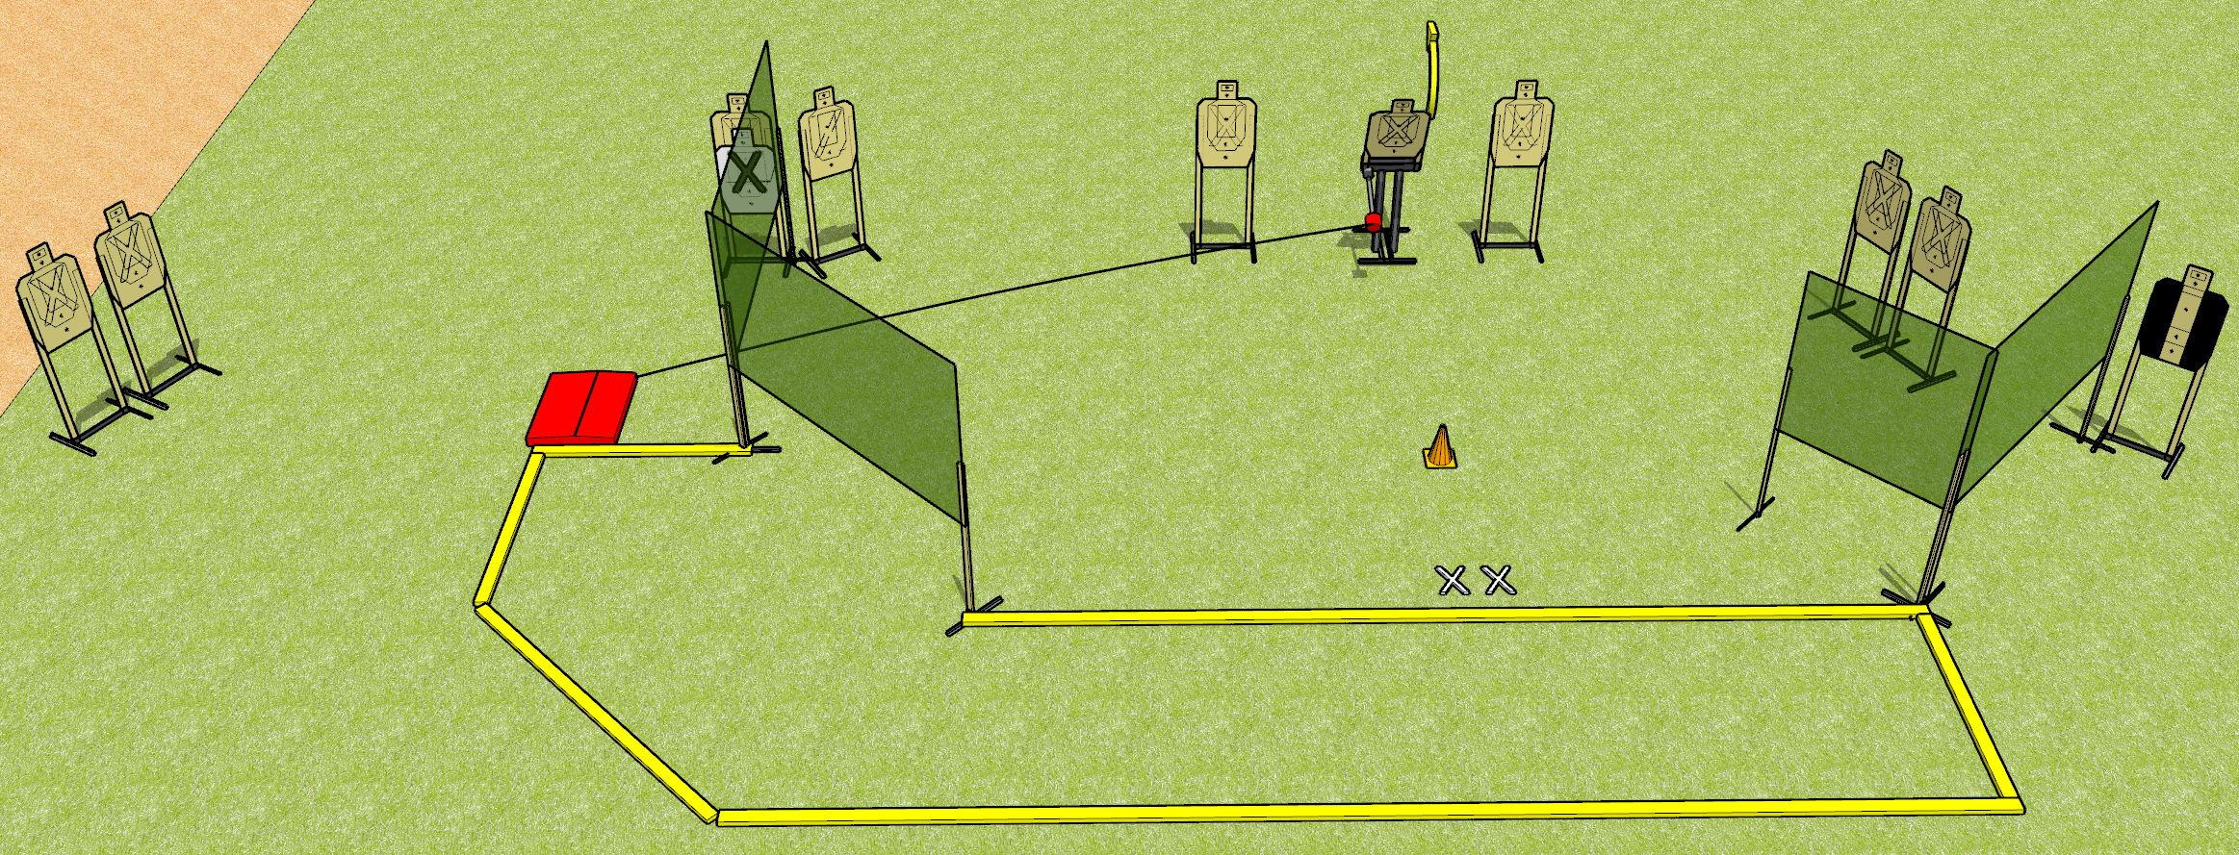
 | Dothan Gun Club – USPSA Match Pop! Course Designer : Drew Coleman
START POSITION : Standing with both feet on X’s, wrists below belt
GUN READY CONDITION : Pistol loaded and holstered. PCC loaded, held with both hands, shouldered, safety on, pointed at orange cone. |  | SCORING: Comstock, 20 rounds TARGETS: 10 paper, 0 Steel SCORED HITS: Best 2 on paper, steel until down START-STOP: Audible, last shot RULES:
STAGE PROCEDURE: Engage targets as they become available from within the fault lines.

Slide 2
Pop!
Written Stage Briefing
Pop! is a 20 round, 100 point, Comstock medium course. There are 10 USPSA targets. The best two hits on paper will score. The start signal is audible.
The popup target is activated by the stomp box and must be activated prior to being engaged. Please check the activators prior to stage walkthrough, and set it up the same way every time.
Handgun start position is standing with both feet on X’s, wrists below belt. Handgun is loaded and holstered.
PCC start position is standing with both feet on X’s, muzzle pointed at orange cone. Loaded carbine is held with both hands, shouldered, safety on.
On start signal, engage targets as they become available from within the shooting area.

